Slide 1
Evaluation of Models – Overview of Models Run
Based on the models run, the Gradient Boosted Classifier seems to be one of our best predictors

Slide 2
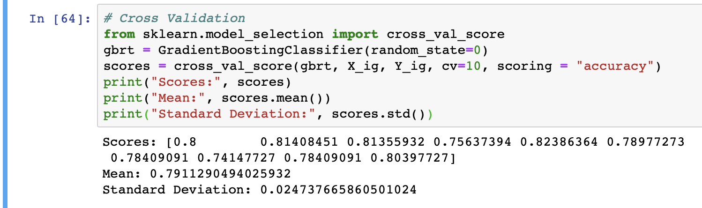
Evaluation of Models
Checking Validity of our Accuracy Score
k-Fold Cross-Validation is a resampling procedure used to evaluate machine learning models on a limited data sample.

Slide 3
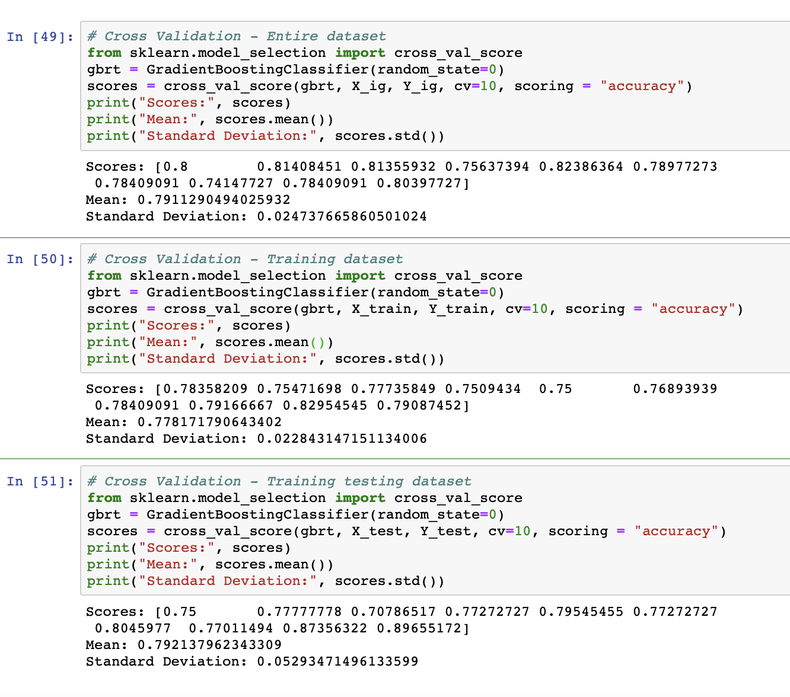
Evaluation of Models
Checking Validity for Overfitting
Our cross validation results on the entire, training, and testing datasets shows that the mean scores are consistent around 0.8 and standard deviations are low. The testing dataset cross validation scores standard deviation is slightly higher. This can be due to the small size of the testing dataset and therefore is not a concern.

Slide 4
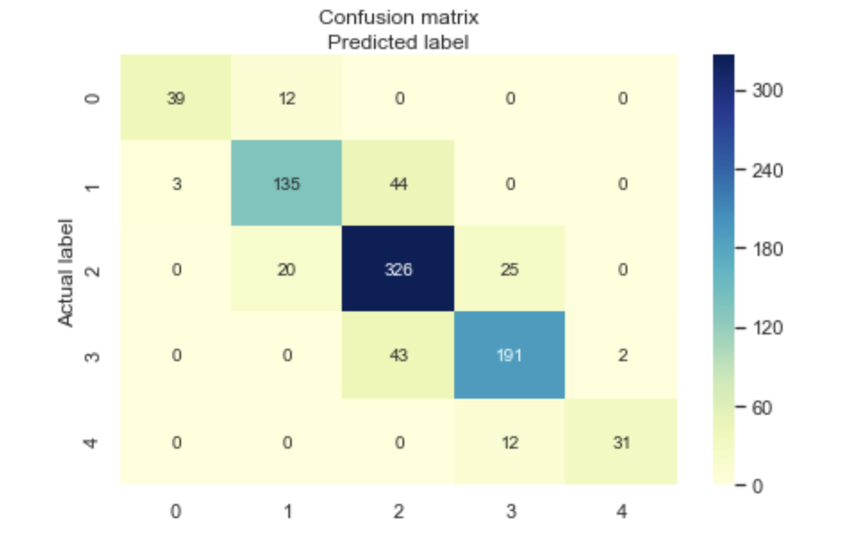
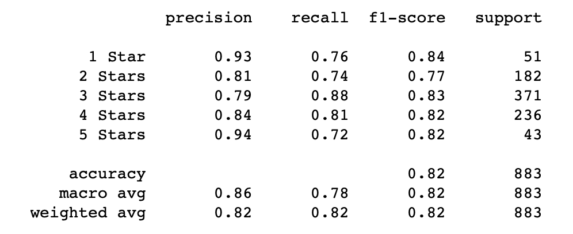
Evaluation of Models
Check for Accuracy Paradox
The accuracy paradox is the paradoxical finding that accuracy is not a good metric for predictive models when classifying in predictive analytics.

Slide 5
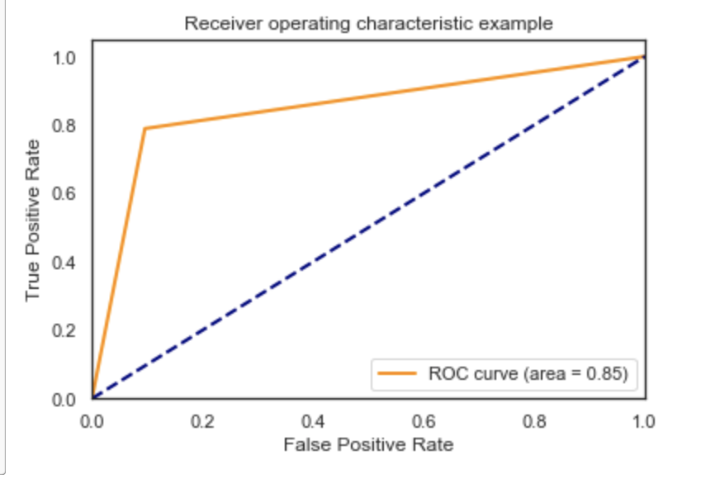
Evaluation of Models
Check our Model Classification Ability - ROC AUC Curve
The AUC (Area Under The Curve) ROC (Receiver Operating Characteristics) curve, also called AUROC (Area Under the Receiver Operating Characteristics), tells how much model is capable of distinguishing between classes. Higher the AUC, better the model is at predicting.

